Slide 1
Chapter 15
Oscillatory Motion

Slide 2
Periodic Motion
Periodic motion : Periodic motion is the repeating motion of an object in which it continues to return to a given position after a fixed time interval.
The beating of your heart, the ticking of a clock, and the movement of a child on a swing. The Earth returns to the same position in its orbit around the Sun each year. In alternating-current electrical circuits, voltage, current, and electric charge vary periodically with time.
One of the key characteristics of a periodic system is the time required for the completion of one cycle of its repetitive motion.
Definition of Period, T: T = time required for one cycle of a periodic motion
SI Unit: seconds/cycle = s
Definition of frequency, f : The frequency of an oscillation is simply the number of oscillations per unit of time.
SI Unit: cycle/ seconds = 1/ s = s⁻¹
1 Hz = 1 cycle/second
The repetitive movements are called oscillations.
A special case of periodic motion called simple harmonic motion will be the focus.
  Simple harmonic motion also forms the basis for understanding mechanical waves.
Oscillations and waves also explain many other phenomena quantity.
  Oscillations of bridges and skyscrapers
  Radio and television
  Understanding atomic theory
Section Introduction

Slide 3
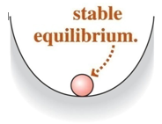
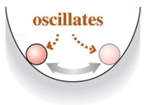
Simple Harmonic Motion
A special kind of periodic motion occurs in mechanical systems when the force acting on the object is proportional to the position of the object relative to some equilibrium position.
  If the force is always directed toward the equilibrium position, the motion is called simple harmonic motion.
  A classic example of simple harmonic motion is provided by the oscillations of a mass attached to a spring.
  A body that undergoes periodic motion always has a stable equilibrium position. When it is moved away from this position and released, a force or torque comes into play to pull it back toward equilibrium.
Introduction

Slide 4
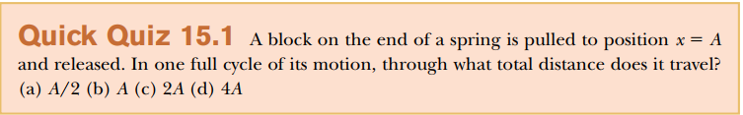

Slide 5
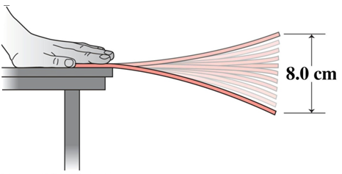
Problem. Oscillating Ruler
An oscillating ruler completes 28 cycles in 10 s & moves a total distance of 8.0 cm. What are the amplitude, period, & frequency of this oscillatory motion?
Amplitude = 8.0 cm / 2 = 4.0 cm.

Slide 6
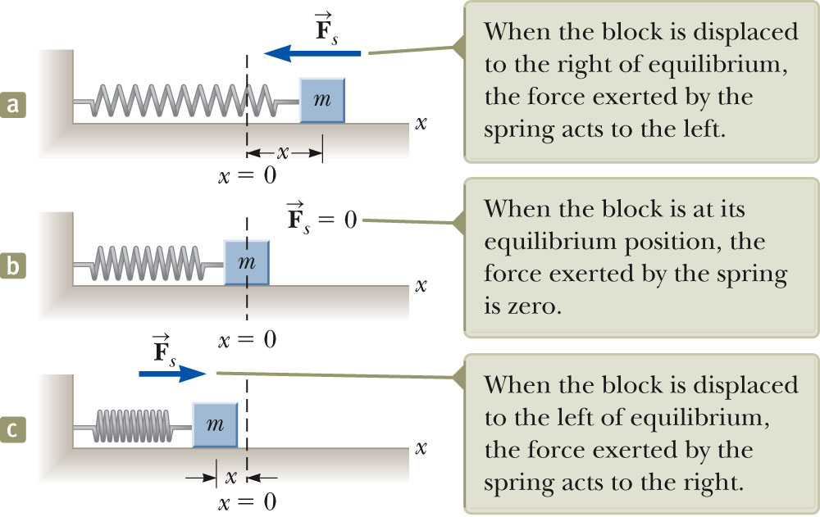
Motion of an Object Attached to a Spring
A block of mass m is attached to a spring, the block is free to move on a frictionless horizontal surface.
When the spring is neither stretched nor compressed, the block is at the equilibrium position.
  x = 0
Such a system will oscillate back and forth if disturbed from its equilibrium position.
Section 15.1

Slide 7
Hooke’s Law
When the block is displaced to a position x, the spring exerts on the block a force that is proportional to the position and given by Hooke’s law
Hooke’s Law states F_{s} = - kx
F_{s} is the restoring force.
It is always directed toward the equilibrium position.
Therefore it is always opposite the displacement from the equilibrium.
K is the force (spring )Constant.
x is the displacement from the mean position.
Section 15.1

Slide 8
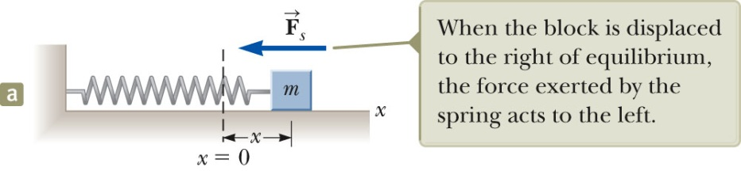
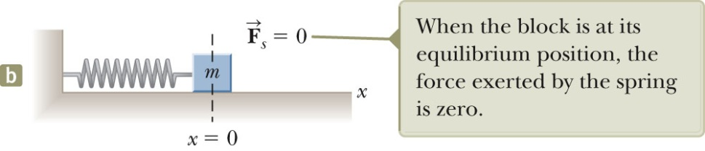
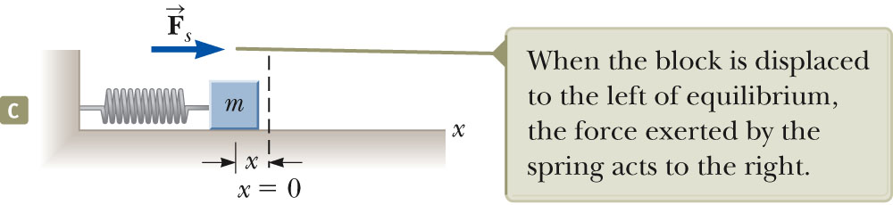
Restoring Force and the Spring Mass System
In a, the block is displaced to the right of x = 0.
  The position is positive.
  The restoring force is directed to the left.
In b, the block is at the equilibrium position x = 0.
  The spring is neither stretched nor compressed.
  The force is 0.
  In c, The block is displaced to the left of x = 0.
  The position is negative.
  The restoring force is directed to the right.
Section 15.1

Slide 9
Acceleration of the spring mass system
When the block is displaced from the equilibrium point and released, it is a particle under a net force and therefore has an acceleration.
The force described by Hooke’s Law is the net force in Newton’s Second Law.
The acceleration is proportional to the displacement of the block.
The direction of the acceleration is opposite the direction of the displacement from equilibrium.
An object moves with simple harmonic motion whenever its acceleration is proportional to its position and is oppositely directed to the displacement from equilibrium.
Section 15.1

Slide 10
Acceleration, cont.
The acceleration is not constant.
  Therefore, the kinematic equations cannot be applied.
  If the block is released from some position x = A, then the initial acceleration is –kA/m.
  When the block passes through the equilibrium position, a = 0.
  At this instant, its speed is a maximum because the acceleration changes sign
  The block continues to x = -A where its acceleration is +kA/m.
  The block continues to oscillate between –A and +A.
In the absence of friction, the motion will continue forever.
  Real systems are generally subject to friction, so they do not actually oscillate forever.
Section 15.1

Slide 11
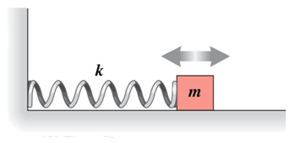
Mathematical Representation of Spring Mass System
As we know
Now Applying Hook’s Law
Let
Applying Newton’s second Law
Solution of differential equation

Slide 12
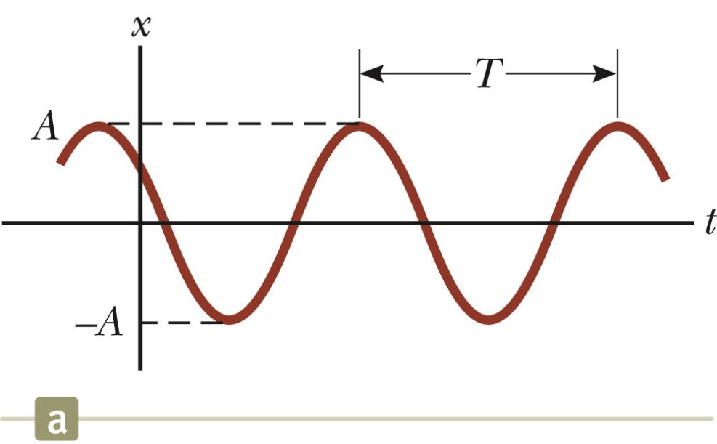
Simple Harmonic Motion – Graphical Representation
Position for an object in SHM
The parameters A, ω, and φ are all constants
A is the amplitude of the motion, is simply the maximum value of the position of the particle in either the positive or negative x direction.
The constant ω, is called angular frequency and has unit rad/s. It is a measure of how rapidly the oscillations are occurring—the more oscillations per unit time, the higher is the value of .
The constant angle φ ( is called the phase constant (or initial phase angle)
Section 15.2

Slide 13
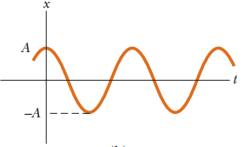
Simple Harmonic Motion, cont.
A and φ are determined uniquely by the position and velocity of the particle at t = 0.
  If the particle is at x = A at t = 0, then φ = 0
The phase of the motion is the quantity (ωt + φ).
x (t) is periodic and its value is the same each time ωt increases by 2π radians.
Section 15.2

Slide 14
Period of spring mass system
The period, T, of the motion is the time interval required for the particle to go through one full cycle of its motion.
  The values of x and v for the particle at time t equal the values of x and v at t + T.
Time Period
After simplification
The frequency represents the number of oscillations the particle undergoes per unit time interval:
Frequency
Section 15.2

Slide 15
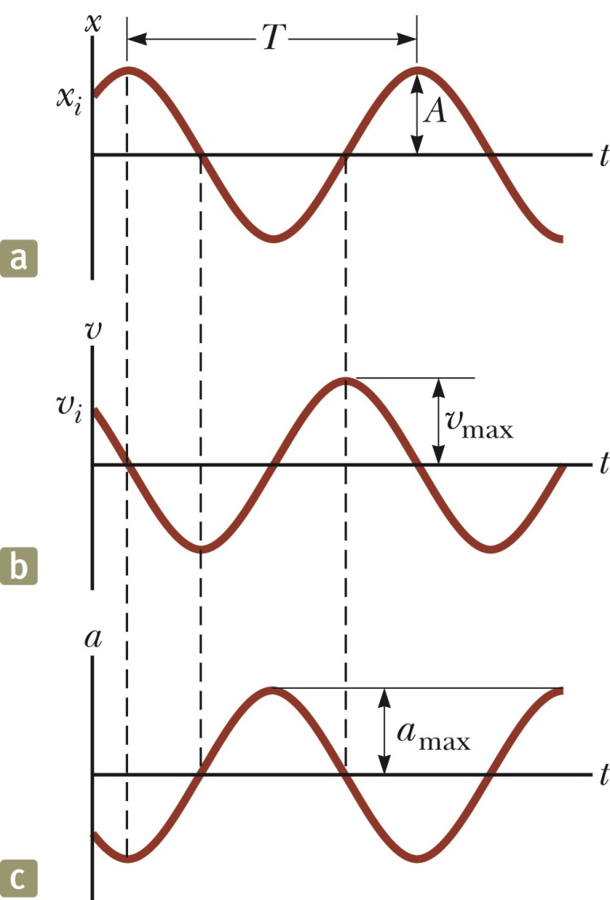
Motion Equations for Simple Harmonic Motion
Simple harmonic motion is one-dimensional and so directions can be denoted by + or - sign.
The velocity is 90º out of phase with the displacement and the acceleration is 180º out of phase with the displacement.
Section 15.2

Slide 16
Maximum Values of v and a
Because the sine and cosine functions oscillate between ±1, we can easily find the maximum values of velocity and acceleration for an object in SHM.
Section 15.2

Slide 17
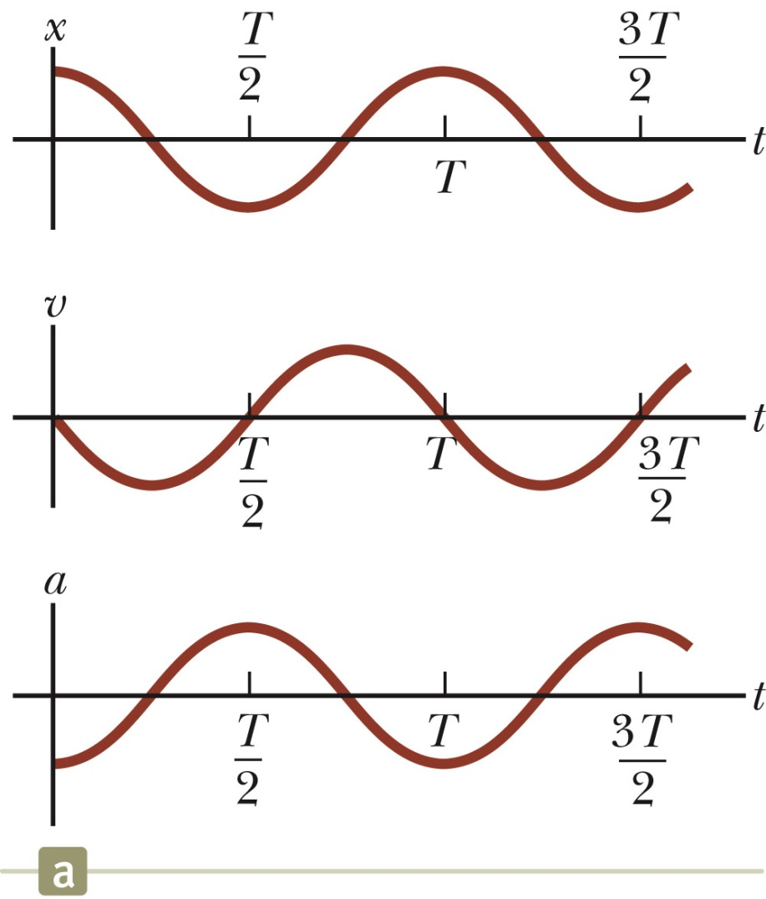
SHM Example 1
Initial conditions at t = 0 are
  x (0)= A
  v (0) = 0
This means φ = 0
The acceleration reaches extremes of ± ω²A at ±A.
The velocity reaches extremes of ± ωA at x = 0.
Section 15.2

Slide 18
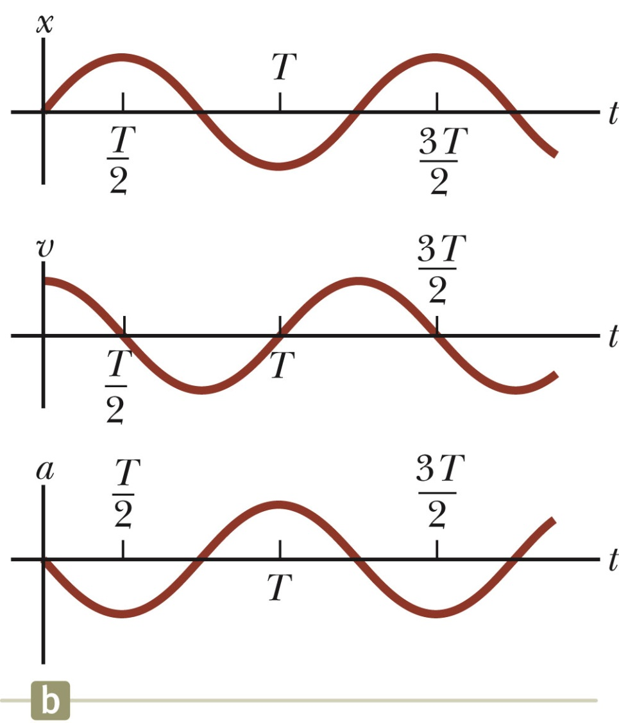
SHM Example 2
Initial conditions at t = 0 are
  x (0)=0
  v (0) = v_{i}
This means φ = − π / 2
The graph is shifted one-quarter cycle to the right compared to the graph of x (0) = A.
Section 15.2

Slide 19
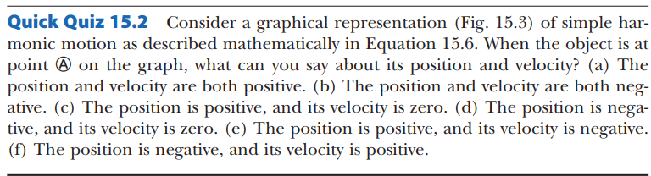
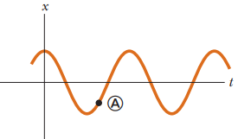
Figure:15.3

Slide 20
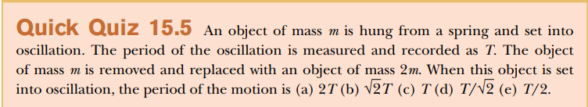

Slide 21
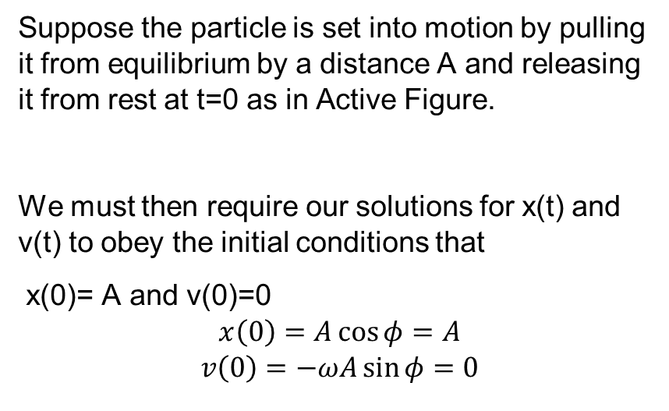
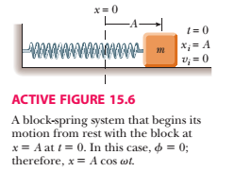
SHM Example 1

Slide 22
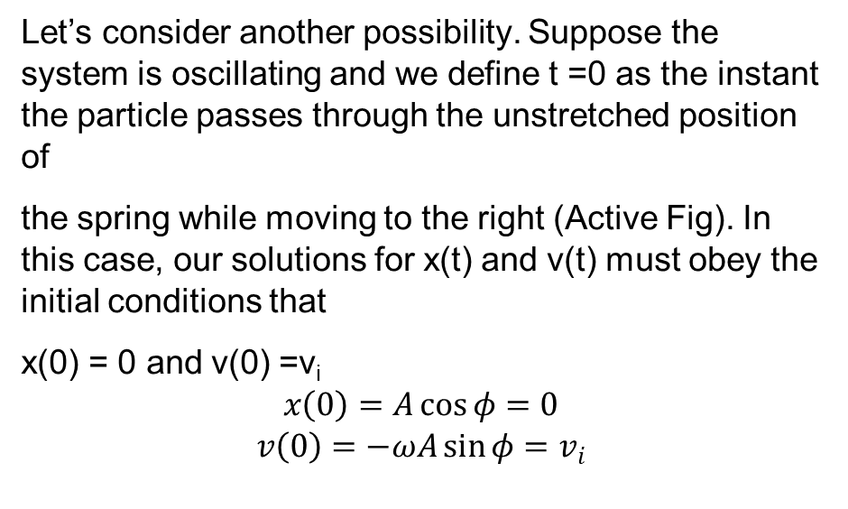
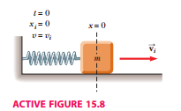
SHM Example 2
The first of these condition tells us φ = ± π⁄2, while the second condition tells us that
We must have φ= −π⁄2

Slide 23
Problem 1:
An object oscillates with simple harmonic motion along the x axis. Its position varies with time according to the equation , where t is in seconds and the angles in the parentheses are in radians.
Determine the amplitude, frequency, and period of the motion.
Calculate the velocity and acceleration of the object at any time t.
Using the results of part (B), determine the position, velocity, and acceleration of the object at t = 1.00 s.
Determine the maximum speed and maximum acceleration of the object.
Find the displacement of the object between t = 0 and t = 1.00 s

Slide 24
Problem 1: Determine the amplitude, frequency, and period of the motion.
Solution: Given
Amplitude: A = 4 m

Slide 25
Using the results of part (B), determine the position, velocity, and acceleration of the object at t = 1.00 s.
Solution:

Slide 26
Determine the maximum speed and maximum acceleration of the object.
Solution:
At t= 1.00 s

Slide 27
Find the displacement of the object between t = 0 and t = 1.00 s
Solution:

Slide 28
Problem 1: Determine the amplitude, frequency, and period of the motion.
Solution:
The position at t = 0 s
In part C we found that the position at t = 1s, is -2.83 m

Slide 29
Problem 2:
A car with a mass of 1 300 kg is constructed so that its frame is supported by four springs. Each spring has a force constant of 20 000 N/m. If two people riding in the car have a combined mass of 160 kg, find the frequency of vibration of the car after it is driven over a pothole in the road
Solution:
What if? Suppose the two people exit the car on the side of the road. One of them pushes downward on the car and release it so that it oscillates vertically. Is the frequency of the oscillation the same as the value we just calculated?

Slide 30
Problem: 3
A 200-g block connected to a light spring for which the force constant is 5.00 N/m is free to oscillate on a horizontal, frictionless surface. The block is displaced 5.00 cm from equilibrium and released from rest.
Find the period of its motion.
Determine the maximum speed of the block.
What is the maximum acceleration of the block?
Express the position, speed, and acceleration as functions of time.
What If? What if the block is released from the same initial position, x_{i} = 5.00 cm, but with an initial velocity of v_{i} = 0.100 m/s? Which parts of the solution change and what are the new answers for those that do change?

Slide 31
Solution:
Find the period of it motion?
(b) Determine the maximum speed of the block?
(c) What is the maximum acceleration of the block?

Slide 32
Solution:
(D) Express the position, speed and acceleration as function of time?
First we will find phase constant from the initial condition that x = A at t = 0:

Slide 33
Problem: Tuned Mass Damper
The tuned mass damper in New York’s Citicorp Tower consists of a 373-10³ kg concrete block that completes one cycle of oscillation in 6.80 s. The oscillation amplitude in a high wind is 110 cm. Determine the spring constant & the maximum speed & acceleration of the block.
→

Slide 34
Energy of the SHM Oscillator
Mechanical energy is associated with a system in which a particle undergoes simple harmonic motion.
  For example, assume a spring-mass system is moving on a frictionless surface.
Because the surface is frictionless, the system is isolated.
  This tells us the total energy is constant.
The kinetic energy can be found by
  K = ½ mv ² = ½ mω² A² sin² (ωt + φ)
    Assume a massless spring, so the mass is the mass of the block only.
The elastic potential energy can be found by
  U = ½ kx ² = ½ kA² cos² (ωt + φ)
Section 15.3

Slide 35
Energy of the SHM Oscillator
The kinetic energy
And Potential energy
The total energy

Slide 36
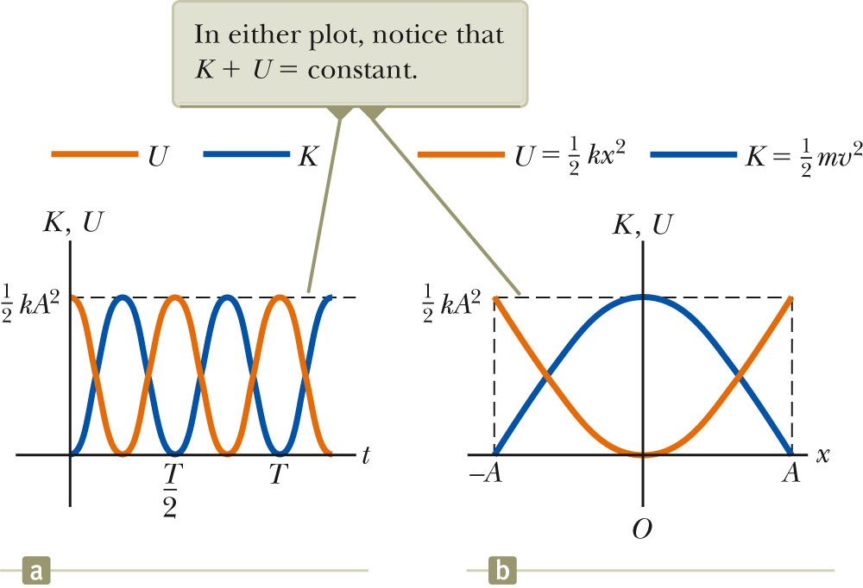
Energy of the SHM Oscillator, cont.
The total mechanical energy is constant.
  At all times, the total energy is
  ½ k A²
The total mechanical energy is proportional to the square of the amplitude.
Energy is continuously being transferred between potential energy stored in the spring and the kinetic energy of the block.
In the diagram, Φ = 0
.
Section 15.3

Slide 37
Energy of the SHM Oscillator, final
Variations of K and U can also be observed with respect to position.
The energy is continually being transformed between potential energy stored in the spring and the kinetic energy of the block.
The total energy remains the same
Section 15.3

Slide 38
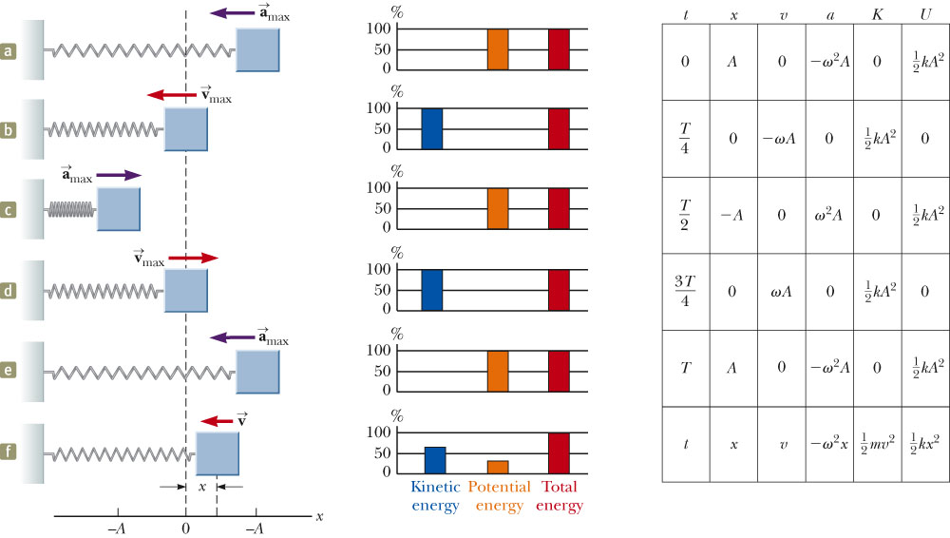
Energy in SHM, summary
Section 15.3

Slide 39
Velocity at a Given Position
Energy can be used to find the velocity:
Section 15.3

Slide 40


Problem 15.4:
A 0.500-kg cart connected to a light spring for which the force constant is 20.0 N/m oscillates on a horizontal, frictionless air track.
(A) Calculate the total energy of the system and the maximum speed of the cart if the amplitude of the motion is
(B) What is the velocity of the cart when the position is 2.00 cm?
(C) Compute the kinetic and potential energies of the system when the position is 2.00 cm.
Solution:

Slide 41
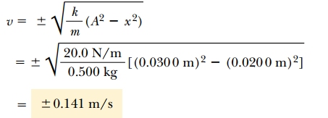
Problem 15.4:
A 0.500-kg cart connected to a light spring for which the force constant is 20.0 N/m oscillates on a horizontal, frictionless air track.
(B) What is the velocity of the cart when the position is 2.00 cm?
(C) Compute the kinetic and potential energies of the system when the position is 2.00 cm.
Solution:

Slide 42


Problem 15.4:
A 0.500-kg cart connected to a light spring for which the force constant is 20.0 N/m oscillates on a horizontal, frictionless air track.
(C) Compute the kinetic and potential energies of the system when the position is 2.00 cm.
Solution:

Slide 43
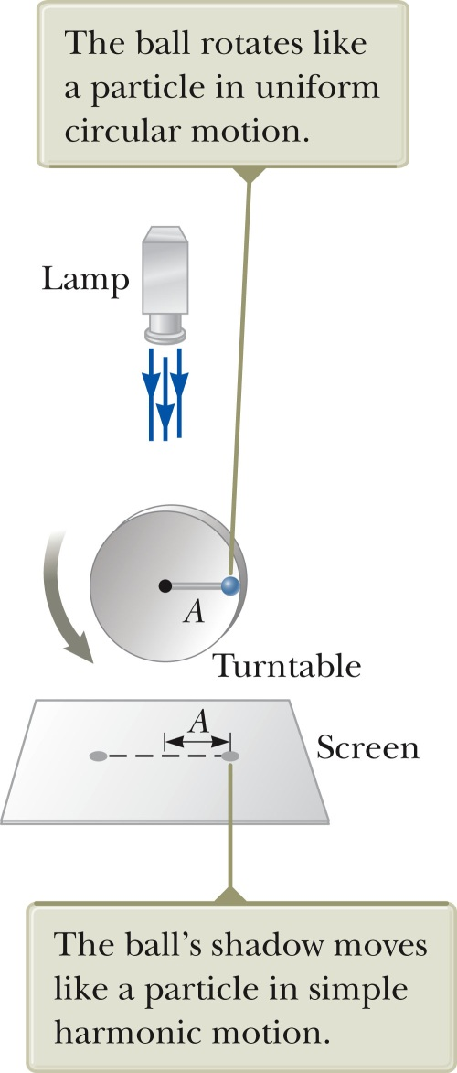
SHM and Circular Motion
This is an overhead view of an experimental arrangement that shows the relationship between SHM and circular motion.
As the turntable rotates with constant angular speed, the ball’s shadow moves back and forth in simple harmonic motion.
Section 15.4

Slide 44
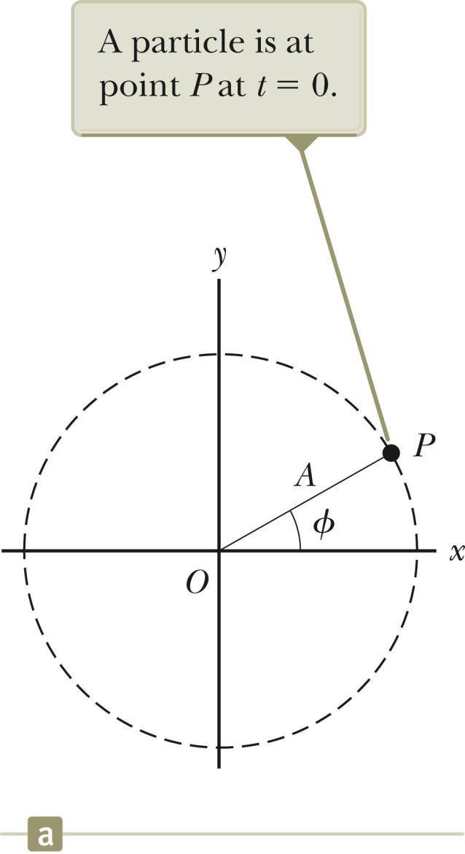
SHM and Circular Motion, 2
The circle is called a reference circle.
  For comparing simple harmonic motion and uniform circular motion.
Take P at t = 0 as the reference position.
Line OP makes an angle φ with the x axis at t = 0.
Section 15.4

Slide 45
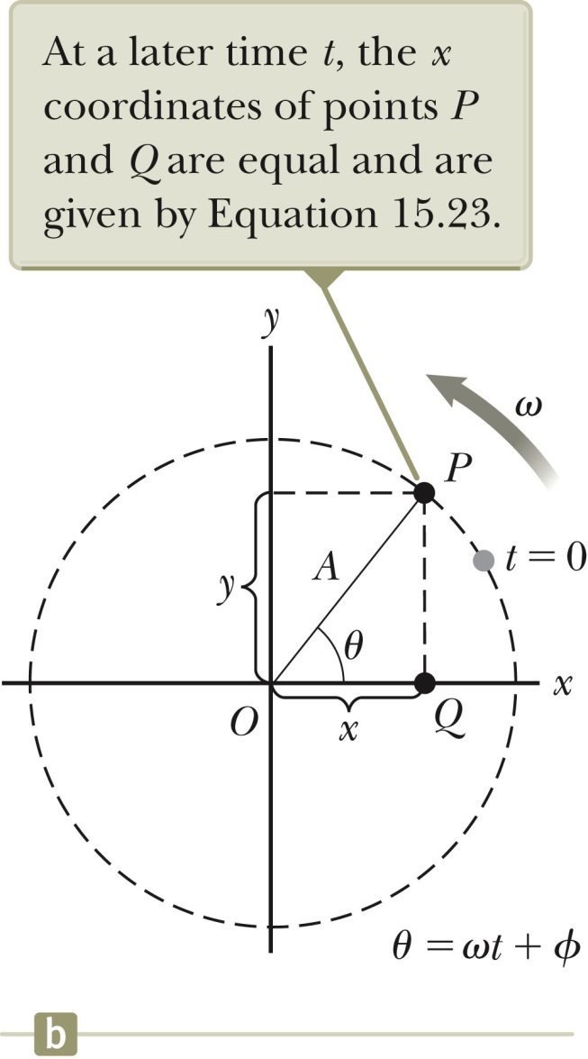
SHM and Circular Motion, 3
The particle moves along the circle with constant angular velocity ω.
OP makes an angle θ with the x axis.
At some time, the angle between OP and the x axis will be θ = ωt + φ.
The points P and Q always have the same x coordinate.
x (t) = A cos (ωt + φ)
This shows that point Q moves with simple harmonic motion along the x axis.
Section 15.4

Slide 46
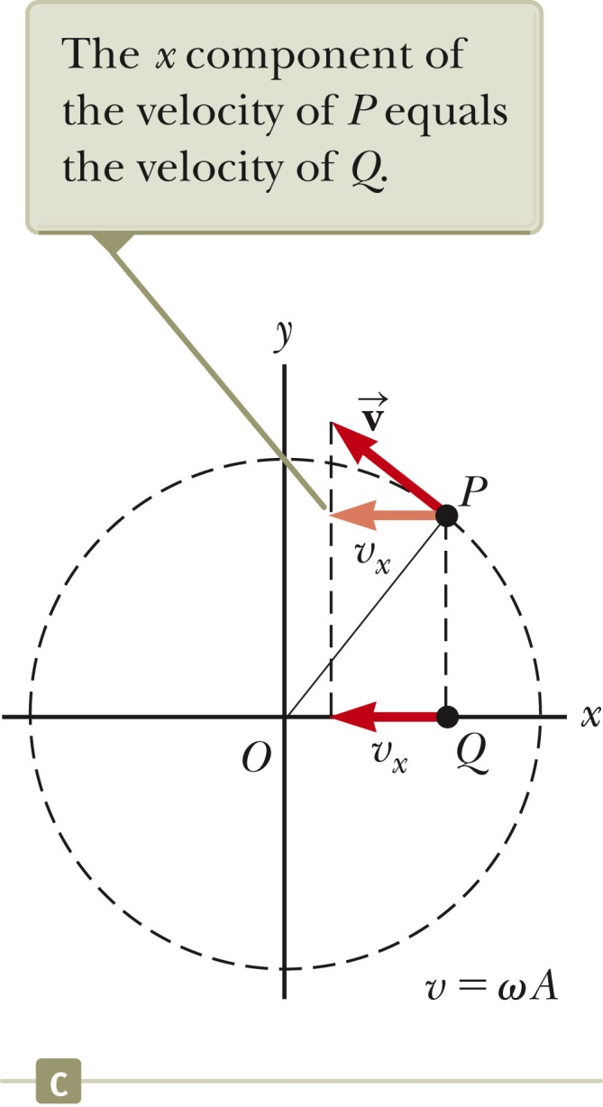
SHM and Circular Motion, 4
The angular speed of P is the same as the angular frequency of simple harmonic motion along the x axis.
Point Q has the same velocity as the x component of point P.
The x-component of the velocity is
v = -ω A sin (ω t + φ)
Section 15.4

Slide 47
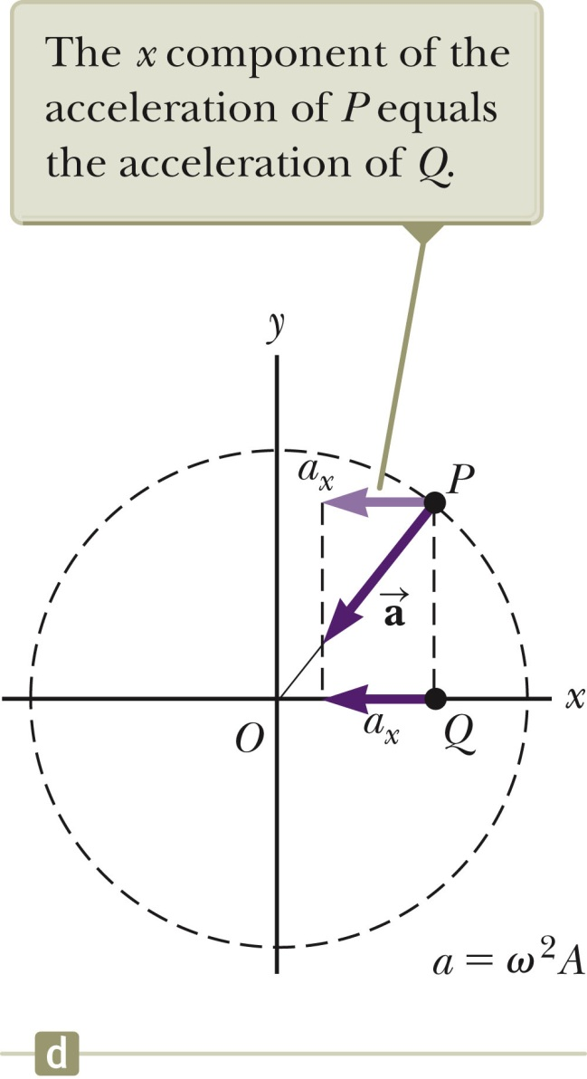
SHM and Circular Motion, 5
The acceleration of point P on the reference circle is directed radially inward.
P ’s acceleration is a = ω²A
The x component is
–ω² A cos (ωt + φ)
This is also the acceleration of point Q along the x axis.
Section 15.4

Slide 48

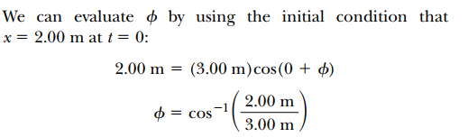
Problem: 15.4
A particle rotates counterclockwise in a circle of radius 3.00 m with a constant angular speed of 8.00 rad/s. At t = 0, the particle has an x coordinate of 2.00 m and is moving to the right.
(A) Determine the x coordinate as a function of time.
Section 15.5

Slide 49
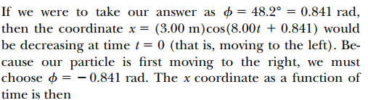

Problem: 15.4
A particle rotates counterclockwise in a circle of radius 3.00 m with a constant angular speed of 8.00 rad/s. At t = 0, the particle has an x coordinate of 2.00 m and is moving to the right.
(A) Determine the x coordinate as a function of time.

Slide 50
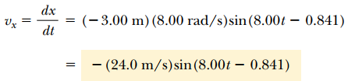
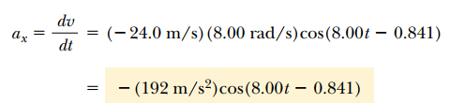

Problem: 15.4
A particle rotates counterclockwise in a circle of radius 3.00 m with a constant angular speed of 8.00 rad/s. At t = 0, the particle has an x coordinate of 2.00 m and is moving to the right.
(B) Find the x components of the particle’s velocity and acceleration at any time t.

Slide 51
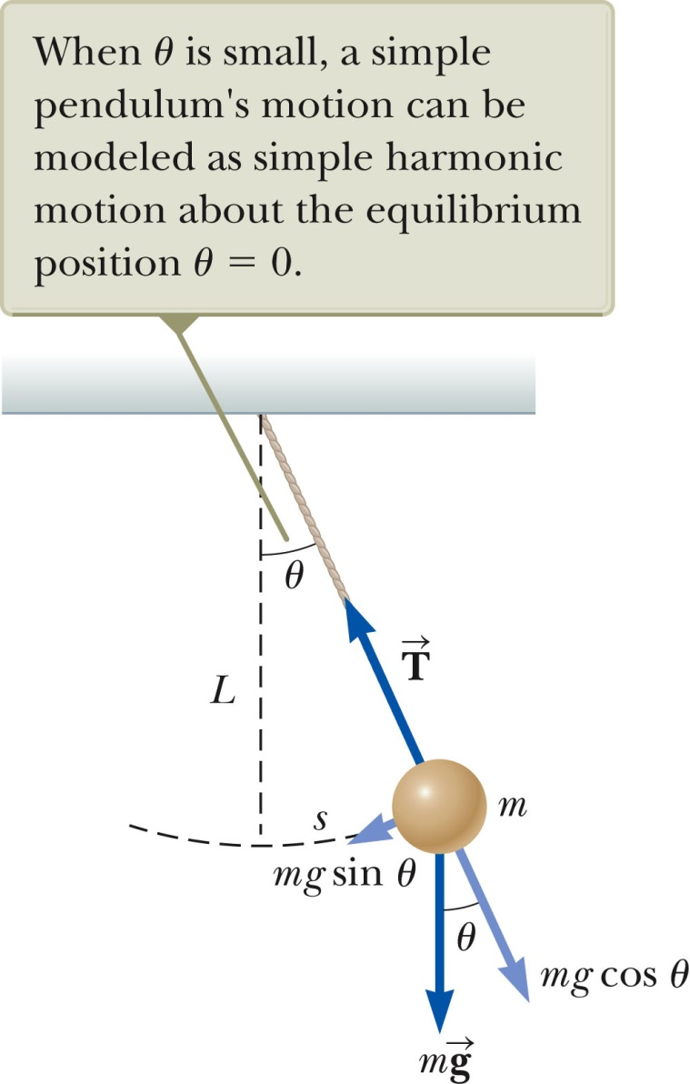
Simple Pendulum
The simple pendulum is another mechanical system that exhibits periodic motion. It consists of a particle-like bob of mass m suspended by a light string of length L. The motion occurs in the vertical plane and is driven by gravitational force. The motion is very close to that of the SHM oscillator.
  If the angle is <10º
Section 15.5

Slide 52
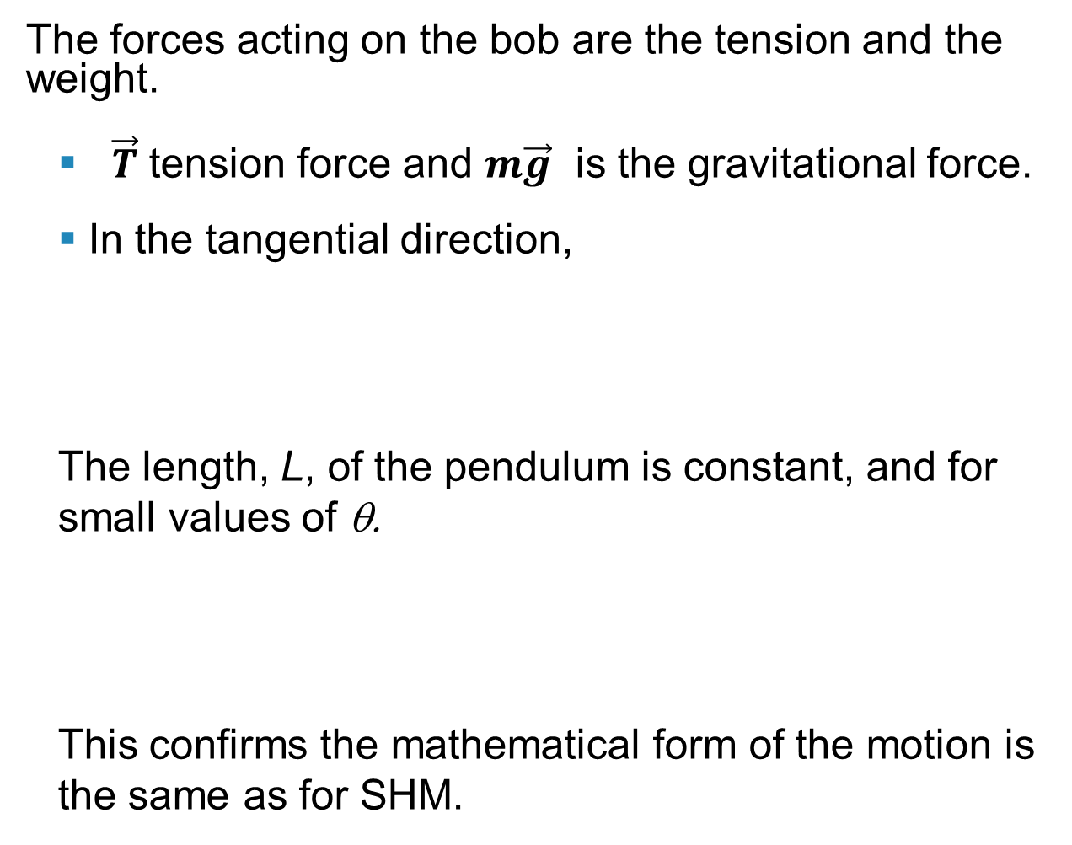

Simple Pendulum

Slide 53
Simple Pendulum
The function θ can be written as θ = θ_{max} cos (ωt + φ).
The angular frequency is
The period is
Section 15.5

Slide 54
Simple Pendulum Summary
The period and frequency of a simple pendulum depend only on the length of the string and the acceleration due to gravity.
The period is independent of the mass.
All simple pendula that are of equal length and are at the same location oscillate with the same period.
Section 15.5

Slide 55
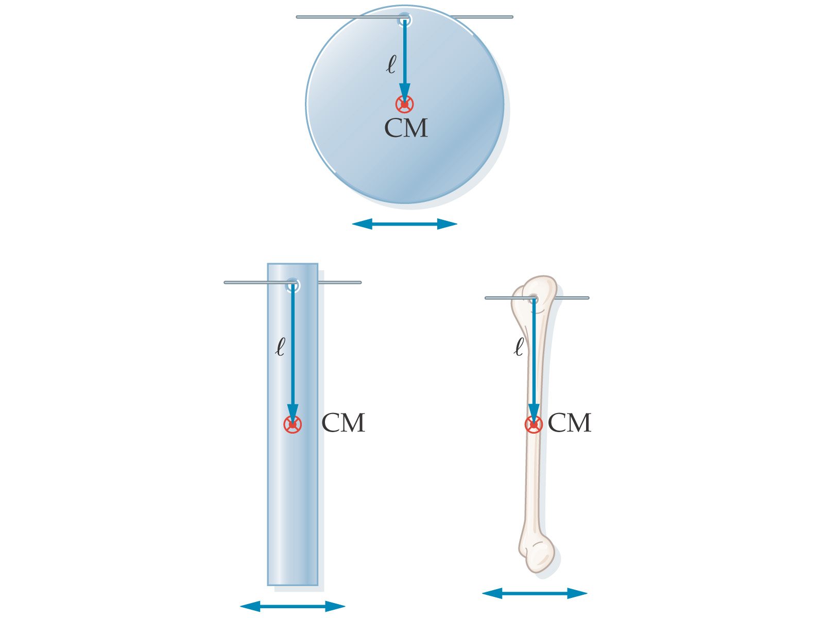
The Physical Pendulum
A physical pendulum is a solid mass that oscillates around its center of mass, but cannot be modeled as a point mass suspended by a massless string. Examples:

Slide 56
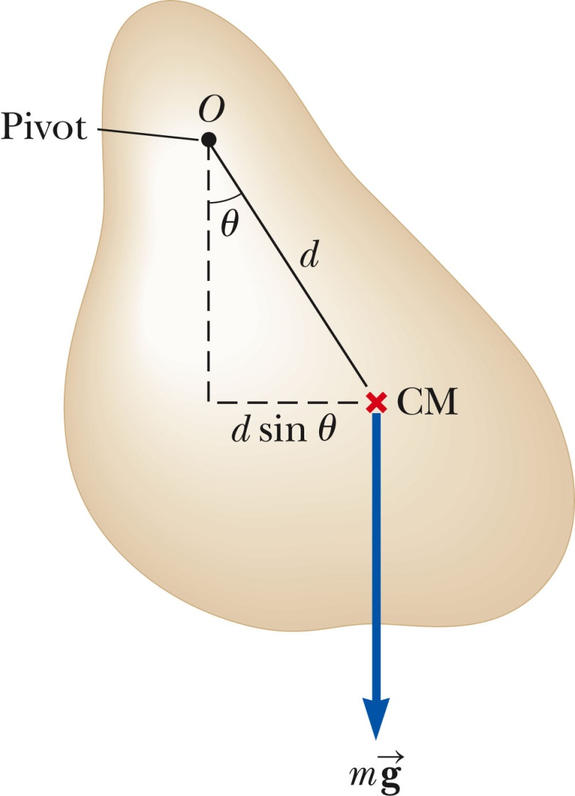
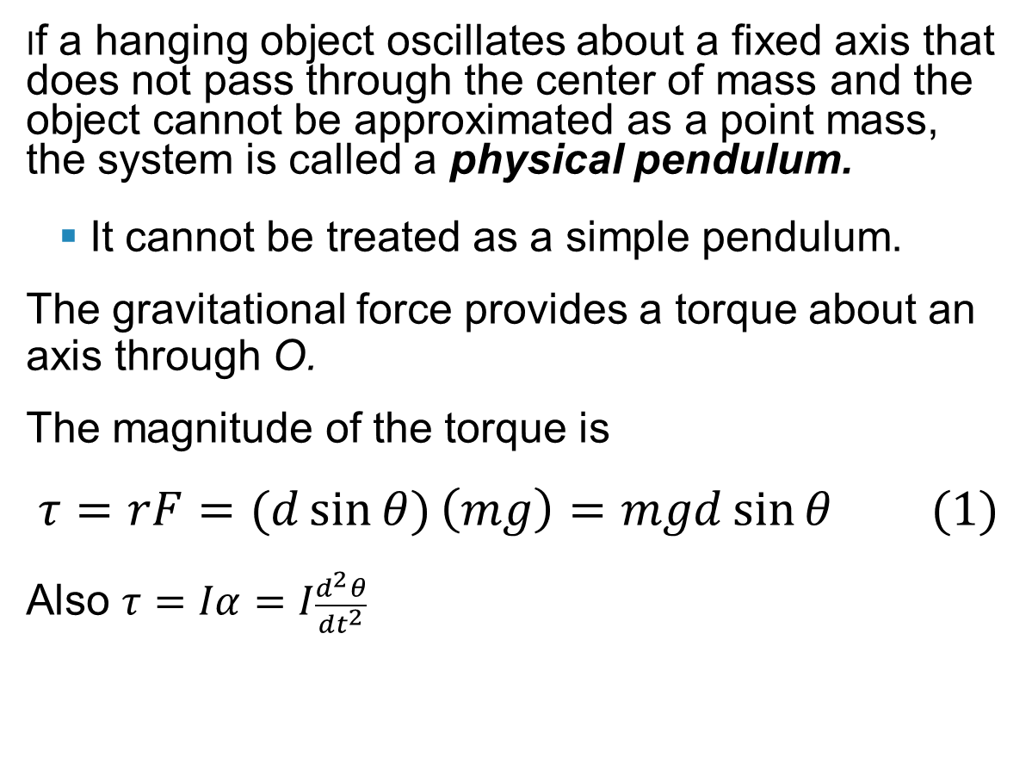
Physical Pendulum
Section 15.5

Slide 57
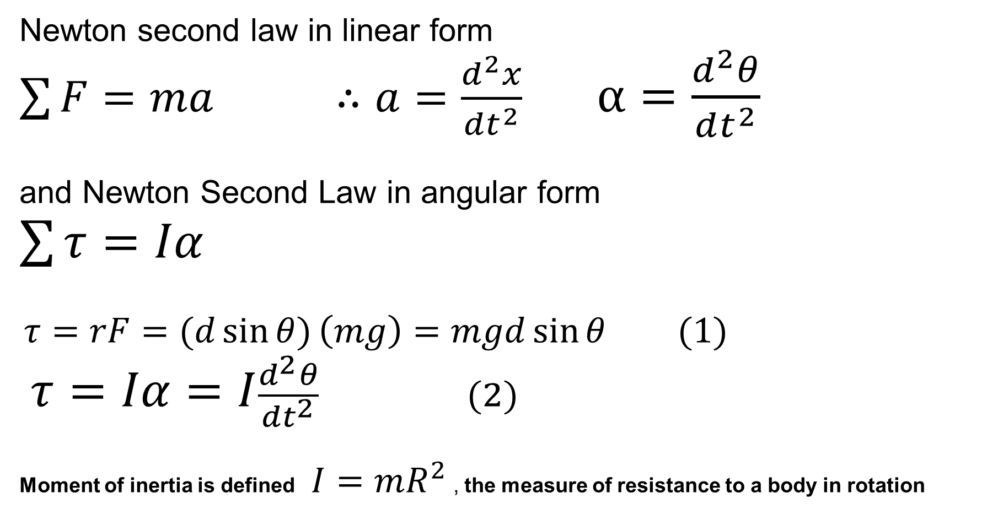
Torque, Moment of Inertia and Newton’s Law

Slide 58
Physical Pendulum
I is the moment of inertia about the axis through O.
From Newton’s Second Law,
The gravitational force produces a restoring force.
Assuming θ is small, this becomes
Section 15.5

Slide 59
Physical Pendulum
This equation is of the same mathematical form as an object in simple harmonic motion.
The solution is that of the simple harmonic oscillator.
The angular frequency is
The period is
Section 15.5

Slide 60
Physical Pendulum
A physical pendulum can be used to measure the moment of inertia of a flat rigid object.
  If you know d, you can find I by measuring the period.
If I = m d² then the physical pendulum is the same as a simple pendulum.
  The mass is all concentrated at the center of mass.
Section 15.5

Slide 61
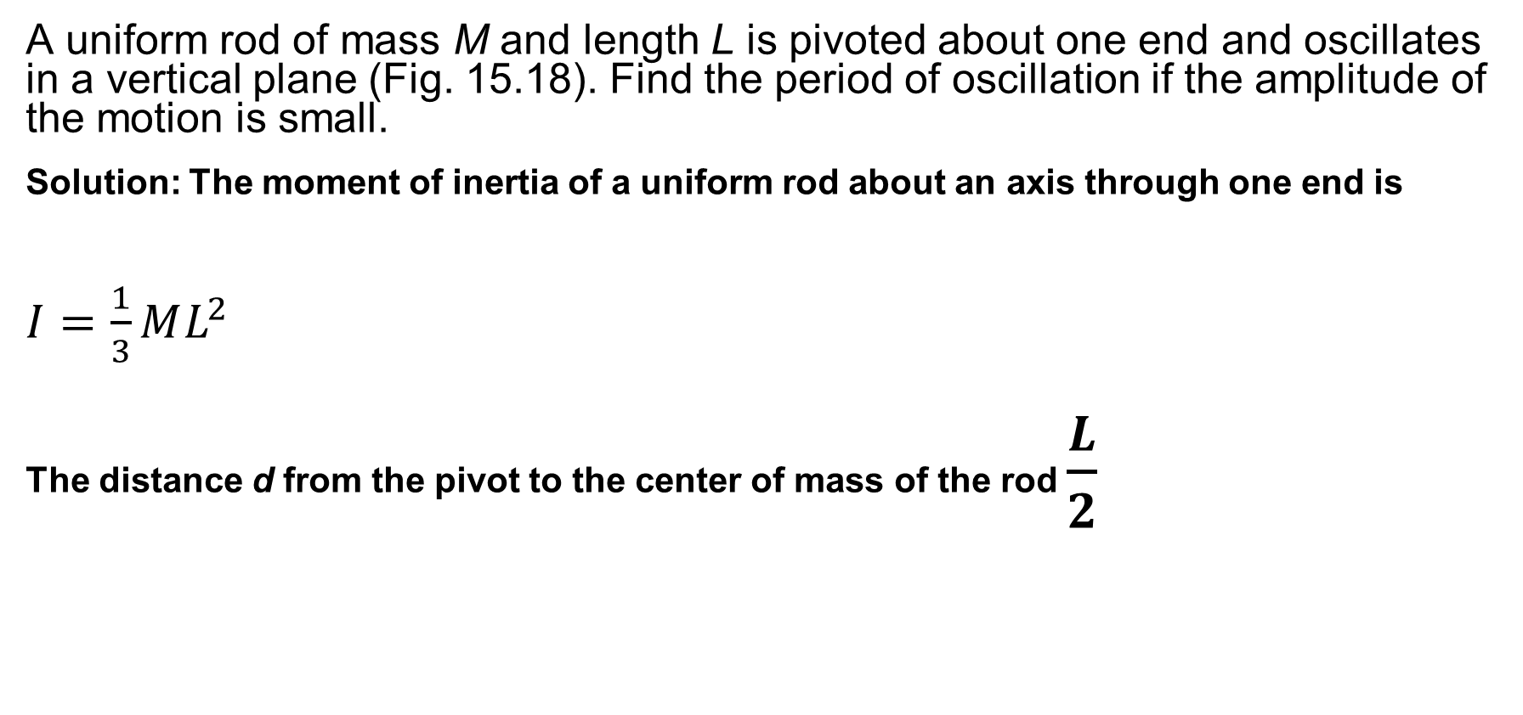
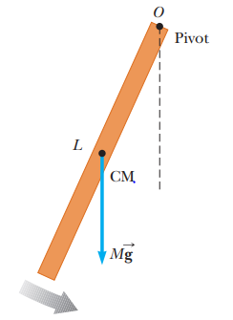

Problem 15.6:

Slide 62
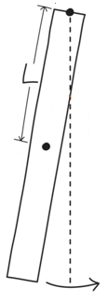
Problem. Walking
When walking, the leg not in contact of the ground swings forward,
acting like a physical pendulum.
Approximating the leg as a uniform rod, find the period for a leg 90 cm long.
Table 10.2
Forward stride = T/2 = 0.8 s

Slide 63
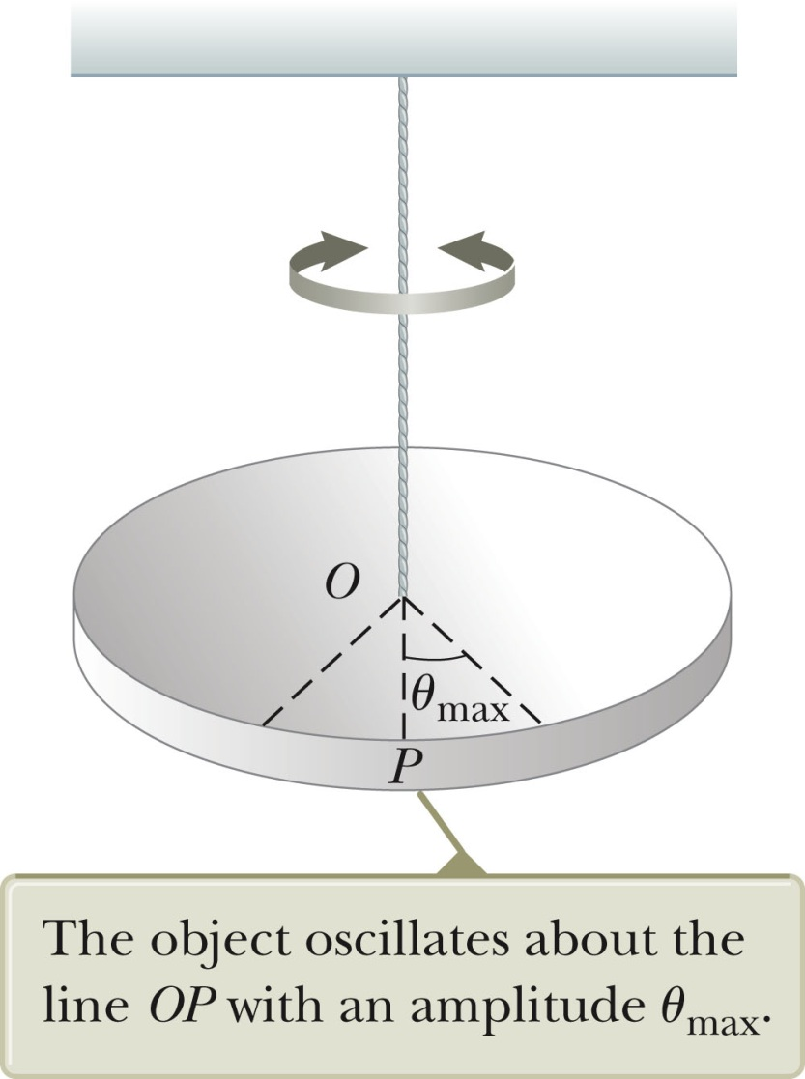
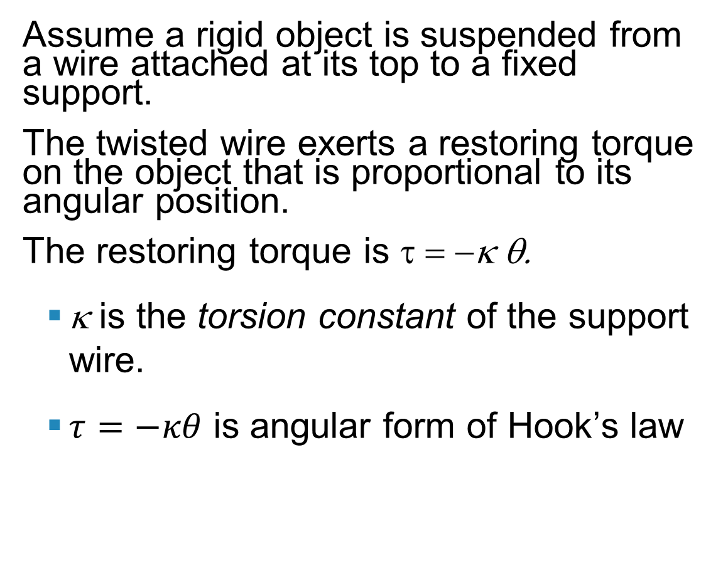
Torsional Pendulum
Assume a rigid object is suspended from a wire attached at its top to a fixed support.
The twisted wire exerts a restoring torque on the object that is proportional to its angular position.
The restoring torque is τ = −κ θ.
  κ is the torsion constant of the support wire.
  $τ=−κθ$ is angular form of Hook’s law
Section 15.5

Slide 64
Torsional Pendulum
Newton’s Second Law gives
The torque equation produces a motion equation for simple harmonic motion.
The angular frequency is
The period is
  No small-angle restriction is necessary.
  Assumes the elastic limit of the wire is not exceeded

Slide 65
Damped Oscillations
In many real systems, non-conservative forces are present.
  This is no longer an ideal system (the type we have dealt with so far).
  Friction and air resistance are common non-conservative forces.
In this case, the mechanical energy of the system diminishes in time, the motion is said to be damped.
Section 15.6

Slide 66
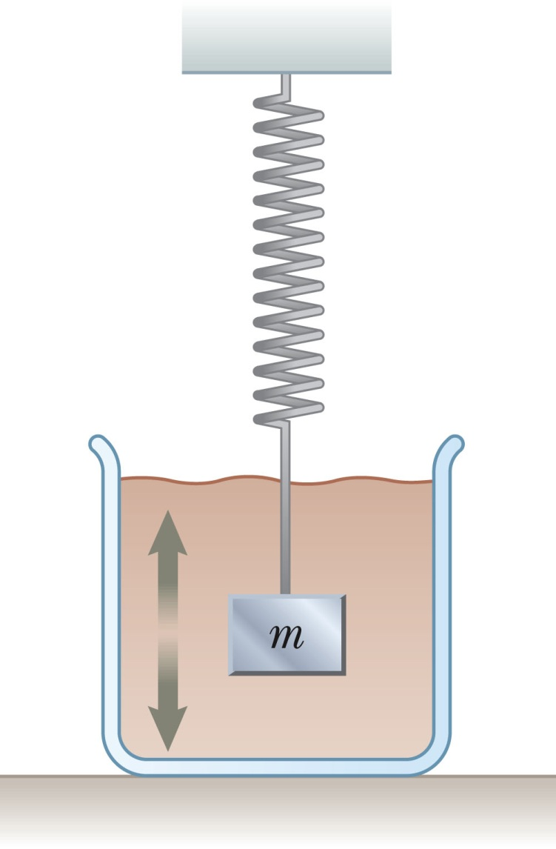
Damped Oscillation, Example
One example of damped motion occurs when an object is attached to a spring and submerged in a viscous liquid.
The retarding force can be expressed as
  b is a constant
  b is called the damping coefficient
Section 15.6

Slide 67
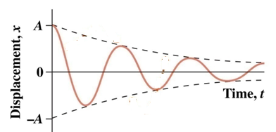
Damped Harmonic Motion
sinusoidal oscillation
Damping (frictional) force:
Damped mass-spring:
Amplitude exponential decay
Ansatz:
→
∴

Slide 68
Damped Oscillations, Equations
From Newton’s Second Law
ΣF_{x} = -k x – bv_{x} = ma_{x}
When the retarding force is small compared to the maximum restoring force we can determine the expression for x.
  This occurs when b is small.
The position can be described by
The angular frequency will be
Section 15.6

Slide 69
Damped Oscillations, Natural Frequency
When the retarding force is small, the oscillatory character of the motion is preserved, but the amplitude decreases exponentially with time.
The motion ultimately ceases.
Another form for the angular frequency:
  where ω₀ is the angular frequency in the absence of the retarding force and is called the natural frequency of the system.
Section 15.6

Slide 70
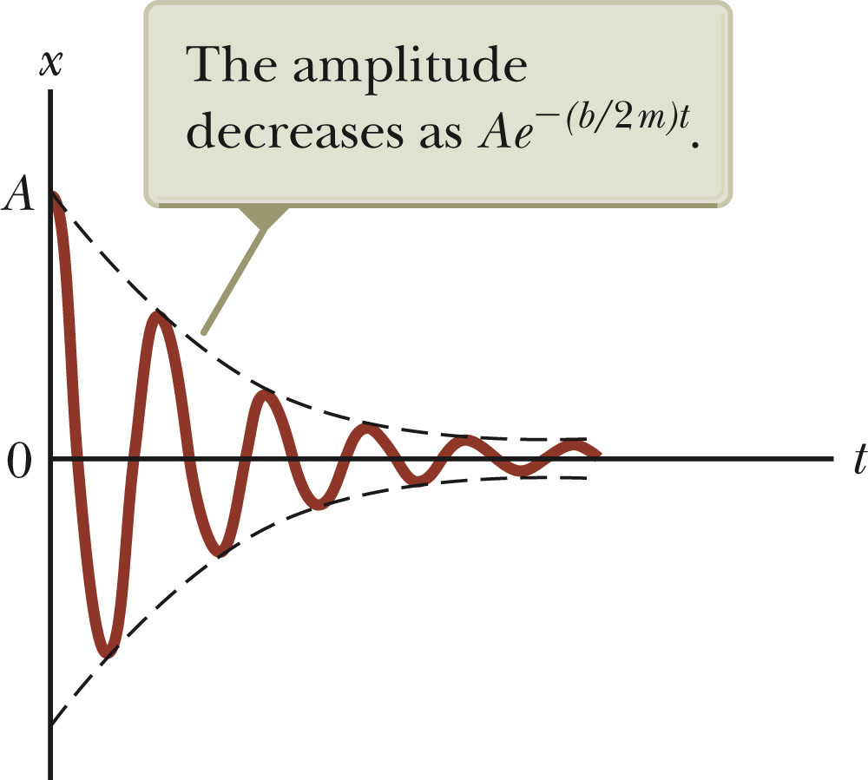
Damped Oscillations, Graph
A graph for a damped oscillation.
The amplitude decreases with time.
The blue dashed lines represent the envelope of the motion.
Use the active figure to vary the mass and the damping constant and observe the effect on the damped motion.
The restoring force is – kx.
Section 15.6

Slide 71
Types of Damping
If the restoring force is such that b/2m < ω_{o}, the system is said to be underdamped.
When b reaches a critical value b_{c} such that b_{c} / 2 m = ω₀ , the system will not oscillate.
  The system is said to be critically damped.
If the restoring force is such that b/2m > ω_{o}, the system is said to be overdamped.
Section 15.6

Slide 72
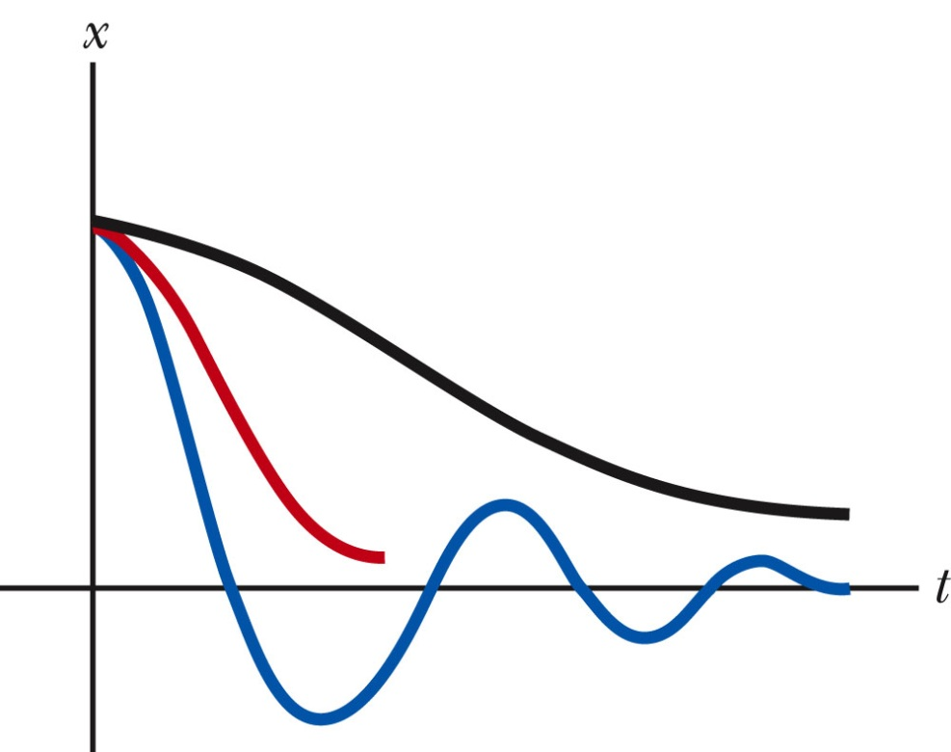
Types of Damping, cont
Graphs of position versus time for
  An underdamped oscillator – blue
  A critically damped oscillator – red
  An overdamped oscillator – black
For critically damped and overdamped there is no angular frequency.
Section 15.6

Slide 73
Forced Oscillations
It is possible to compensate for the loss of energy in a damped system by applying a periodic external force.
The amplitude of the motion remains constant if the energy input per cycle exactly equals the decrease in mechanical energy in each cycle that results from resistive forces.
After a driving force on an initially stationary object begins to act, the amplitude of the oscillation will increase.
After a sufficiently long period of time, E_{driving} = E_{lost to internal}
  Then a steady-state condition is reached.
  The oscillations will proceed with constant amplitude.
Section 15.7

Slide 74
Forced Oscillations, cont.
The amplitude of a driven oscillation is
  ω₀ is the natural frequency of the undamped oscillator.
Section 15.7

Slide 75
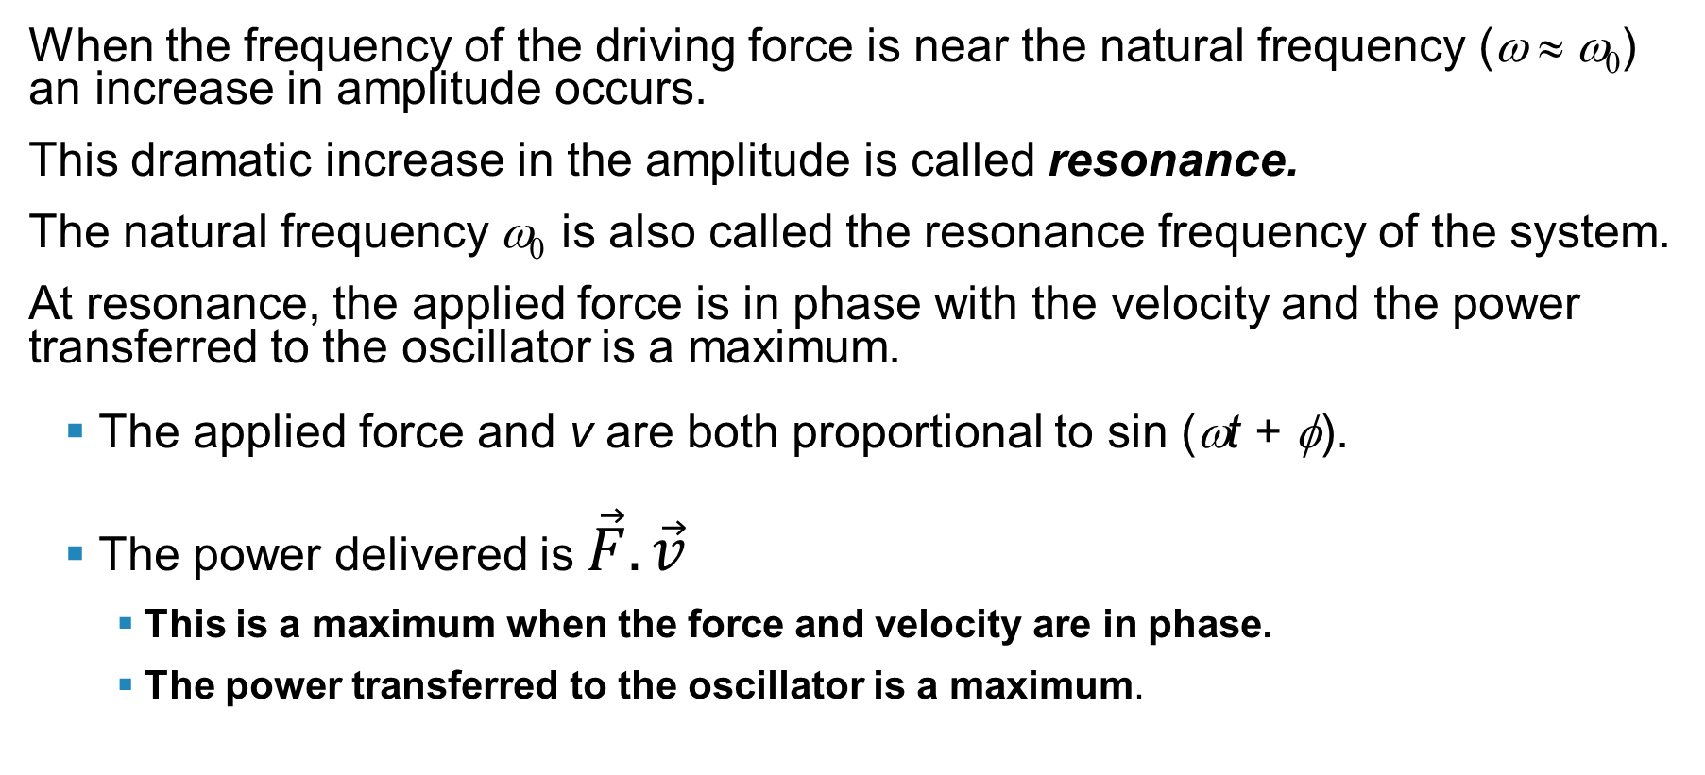
Resonance
When the frequency of the driving force is near the natural frequency (ω ≈ ω₀) an increase in amplitude occurs.
This dramatic increase in the amplitude is called resonance.
The natural frequency ω₀ is also called the resonance frequency of the system.
At resonance, the applied force is in phase with the velocity and the power transferred to the oscillator is a maximum.
  The applied force and v are both proportional to sin (ωt + φ).
  The power delivered is $\vec{F}.\vec{v}$
    This is a maximum when the force and velocity are in phase.
    The power transferred to the oscillator is a maximum.
Section 15.7

Slide 76
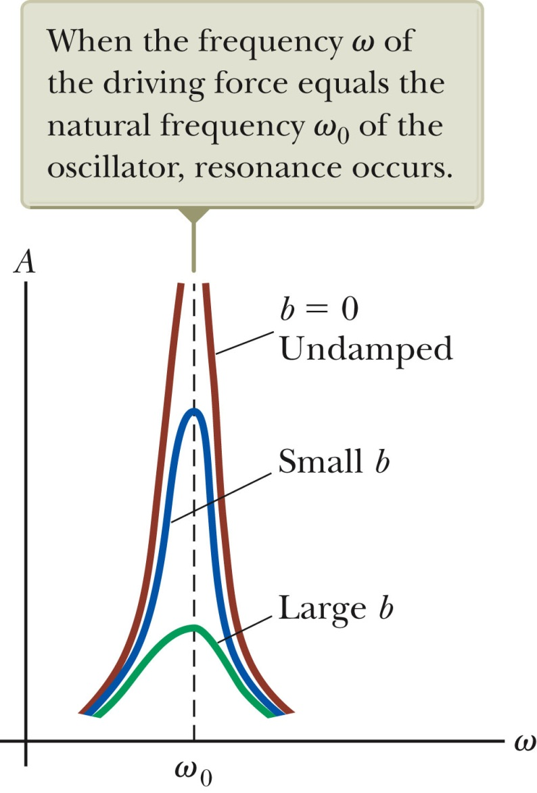
Resonance, cont.
Resonance (maximum peak) occurs when driving frequency equals the natural frequency.
The amplitude increases with decreased damping.
The curve broadens as the damping increases.
The shape of the resonance curve depends on b.
Section 15.7

Slide 77
Practice Problem
A 50-g mass is attached to a spring and undergoes simple harmonic motion. Its maximum acceleration is 15 m/s² and its maximum speed is 3.5 m/s.
Determine the (a) angular frequency, (b) spring constant, and (c) amplitude.

Slide 78
Practice Problem
A 2.00-kg object is attached to a spring and placed on a frictionless, horizontal surface. A horizontal force of 20.0 N is required to hold the object at rest when it is pulled to x = 0.200 m from its equilibrium position (at x = 0), and then released from rest and it subsequently undergoes simple harmonic oscillations.
(a) Find the force constant of the spring, k, and the frequency of the oscillations, ƒ.
(b) Calculate the maximum speed of the object, v_{max}. Where does this maximum speed occur?
(c) Find the maximum acceleration of the object, a_{max.} Where does the maximum acceleration occur?
(d) Calculate the total energy of the oscillating system.
(e) Determine the speed and the acceleration of the object when its position is equal to one-third the maximum value,
(f) Express the position, velocity, and acceleration as functions of time,
x(t), v(t), a(t)
.

Slide 79
Practice Problem
A particle moving along the x axis in simple harmonic motion starts from its equilibrium position, the origin, at t = 0 sec and moves to the right. The amplitude of its motion is A = 2.00 cm, and the frequency is ƒ = 1.50 Hz.
(a) Find an expression for the position of the particle as a function of time.
(b) Determine the maximum speed and maximum positive acceleration of the particle.
(d) Find the total distance traveled by the particle between t = 0 and t = 1.00 s.

Slide 80
Practice Problem
1. What is the period of 60.0 Hz electrical power?
2. If your heart rate is 150 beats per minute during strenuous exercise, what is the time per beat in units of seconds?
3. Find the frequency of a tuning fork that takes 2.50×10⁻³ s to complete one oscillation.
4. A stroboscope is set to flash every 8.00×10⁻⁵s. What is the frequency of the flashes?
5. (a) What is the maximum velocity of an 85.0-kg person bouncing on a bathroom scale having a force constant of 1.50×10⁶ N/m, if the amplitude of the bounce is 0.200 cm? (b)What is the maximum energy stored in the spring?

Slide 81
Practice Problem
Consider a spring that is standing on end in the vertical position. You place 100 grams on the spring and it compresses a distance of 9.8 cm.
If an additional 200 grams are placed on top of the 100 gram mass, how much will the spring compress?
What is the spring constant?

Slide 82
Practice Problem
A spring is hanging freely from the ceiling. You attach an object to the end of the spring and let the object go. It falls down a distance 49 cm and comes back up to where it started. It continues to oscillate in simple harmonic motion going up and down a total distance of 49 cm from top to bottom. What is the period of the simple harmonic motion?

Slide 83

Practice Problem
You are on a boat, which is bobbing up and down. The boat's vertical displace­ment y is given by
$$y=A\cos\left(ωt+φ\right)$$
(a) Find the amplitude, angular frequency , phase constant, frequency, and pe­riod of the motion. (b) Where is the boat at t = 1 s? (c) Find the velocity and ac­celeration as functions of time t. (d) Find the initial values of the position, velocity, and acceleration of the boat.

Slide 84


Practice Problem
A 450-g mass on a spring is oscillating at 1.2 Hz, with total energy 0.51 J. What’s the oscillation amplitude?
$$f=2πω$$
$$ω=\frac{f}{2π}$$
$$\frac{f}{2π}=\sqrt{\frac{k}{m}}$$
$$E=\frac{1}{2}kA^{2}$$

